Slide 1
Introduction to
International Business Administration

Slide 2
International Trade Theory
Notes:
This is a test

Slide 3
Prof. Dr. Amit Shah
Notes:
This is a test

Slide 4
Introduction
What is international trade?
  Exchange of raw materials and manufactured goods (and services) across national borders
  Motivation for trade is to realize gains from trade.
  Economists generally advocate for lower barriers to cross-border trade, both in goods and services.
  Recent shift in U.S. trade policy away from free trade and toward managed trade.
Trade and investment policies have an extremely important impact on international business practices.
Notes:
When economists talk about the gains from trade, what they mean is that trade allows countries to specialize in the production (and export) of goods and services that they can produce most efficiently, while importing goods and services that they cannot produce so efficiently from other nations.

Slide 5
International Trade Theory
Classical trade theories:
  explain national economy conditions--country advantages--that enable such exchange to happen
New trade theories:
  explain links among natural country advantages, government action, and industry characteristics that enable such exchange to happen

Slide 6
Trade Theories
Mercantilism (16th and 17th century)
  Takes an us-versus-them view of trade
  Other country’s gain is our country’s loss
Free Trade theories
  Absolute Advantage (Adam Smith, 1776)
  Comparative Advantage (David Ricardo, 1817)
  Specialization of production and free flow of goods benefit all trading partners’ economies
New Trade Theories

Slide 7
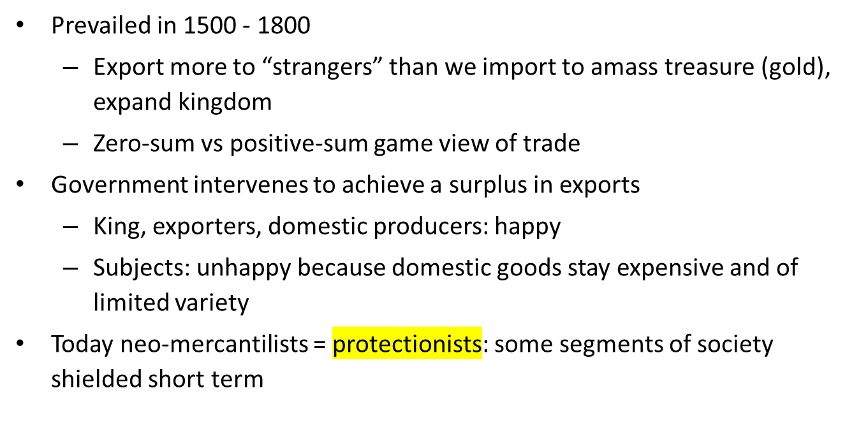

Mercantilism/Neo-mercantilism
Notes:
You export as much as possible and try to amass as much gold as possible
„I win, you loose“
Weakens any country in the long run

Slide 8
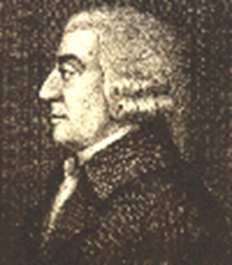
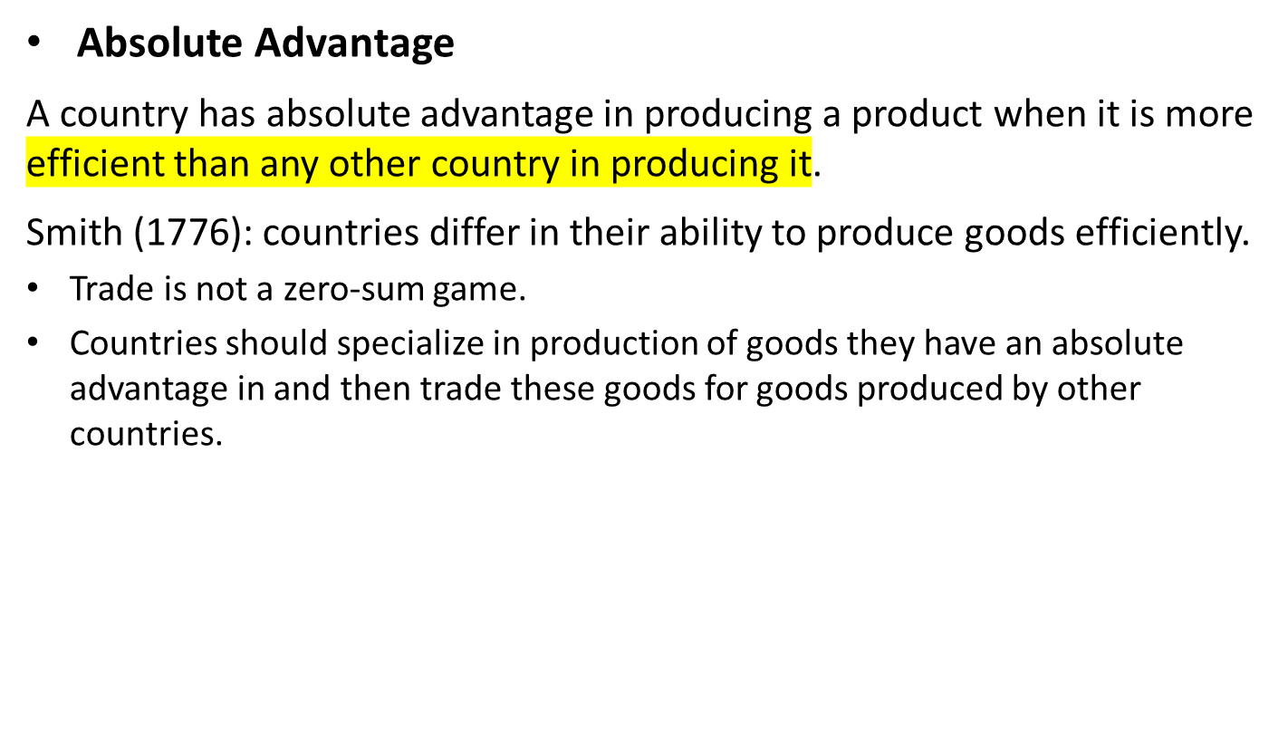
Absolute Advantage
Notes:
In his 1776 landmark book The Wealth of Nations, Adam Smith attacked the mercantilist assumption that trade is a zero-sum game. Smith argued that countries differ in their ability to produce goods efficiently.
Absolute advantage: what youre absolutely better at (what youre the best/efficient at) producing
Trade not zero-sum → can expand the pie; everybody can profit

Slide 9
Absolute Advantage and the Gains from Trade
Resources Required to Produce 1 Ton of Cocoa and Rice
 | Cocoa | Rice
Ghana | 10 | 20
South Korea | 40 | 10
Production and Consumption without Trade
 | Cocoa | Rice
Ghana | 10.0 | 5.0
South Korea | 2.5 | 10.0
Total Production | 12.5 | 15.0
Production with Specialization
 | Cocoa | Rice
Ghana | 20.0 | 0.0
South Korea | 0.0 | 20.0
Total Production | 20.0 | 20.0
Notes:
We can see that trade is a positive-sum game; it produces net gains for all involved.
When specialized they all in all produce more than without specialization

Slide 10
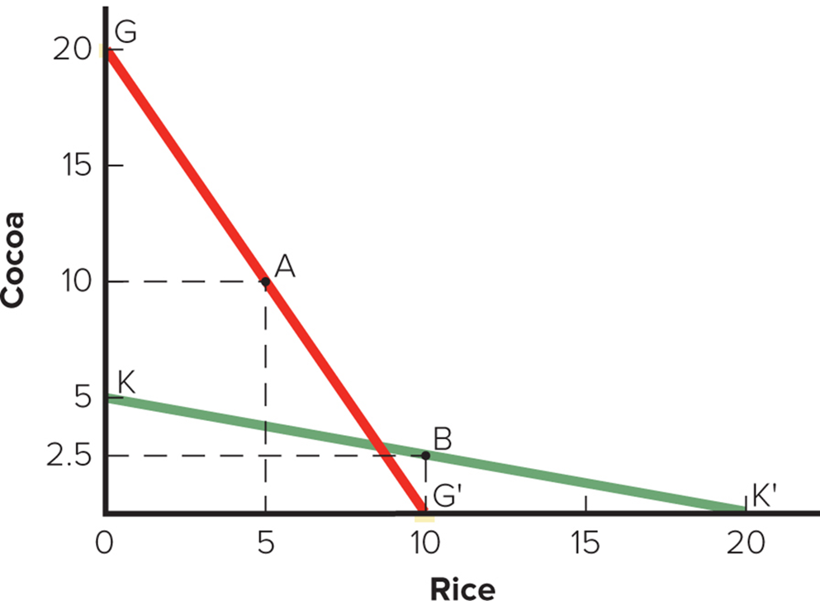
The Theory of Absolute Advantage
Notes:
Assume that two countries, Ghana and South Korea, both have 200 units of resources that could either be used to produce rice or cocoa. In Ghana, it takes 10 units of resources to produce one ton of cocoa and 20 units of resources to produce one ton of rice. So, Ghana could produce 20 tons of cocoa and no rice, 10 tons of rice and no cocoa, or some combination of rice and cocoa between the two extremes.
In South Korea it takes 40 units of resources to produce one ton of cocoa and 10 resources to produce one ton of rice. So, South Korea could produce 5 tons of cocoa and no rice, 20 tons of rice and no cocoa, or some combination in between.
Ghana has an absolute advantage in the production of cocoa.
South Korea has an absolute advantage in the production of rice.

Slide 11
Absolute Advantage and the Gains from Trade
Consumption after Ghana Trades 6 Tons of Cocoa for 6 Tons of South Korean Rice
 | Cocoa | Rice
Ghana | 14.0 | 6.0
South Korea | 6.0 | 14.0
Increase in Consumption as a Result of Specialization and Trade
 | Cocoa | Rice
Ghana | 4.0 | 1.0
South Korea | 3.5 | 4.0
Notes:
We can see that trade is a positive-sum game; it produces net gains for all involved.

Slide 12
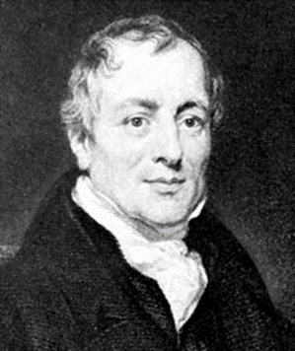
Comparative Advantage
Theory of Comparative Advantage
  Ricardo (18 17): What happens when one country has an absolute advantage in the production of all goods?
  A country should specialize in production of goods that it produces most efficiently and buy goods that it produces less efficiently from other countries.
Notes:
Ricardo’s theory holds that this is true, even if it means the country buys goods from other countries that it could produce more efficiently itself.
Comparative advantage: specialize in production of goods in which is relatively (compared to the other) more productive

Slide 13
Comparative Advantage and the Gains from Trade
Resources Required to Produce 1 Ton of Cocoa and Rice
 | Cocoa | Rice
Ghana | 10 | 13.33
South Korea | 40 | 20
Production and Consumption without Trade
 | Cocoa | Rice
Ghana | 10.0 | 7.5
South Korea | 2.5 | 5.0
Total Production | 12.5 | 12.5
Production with Specialization
 | Cocoa | Rice
Ghana | 15.0 | 3.75
South Korea | 0.0 | 10.0
Total Production | 15.0 | 13.75
Notes:
The theory of comparative advantage suggests that trade is a positive-sum game in which all countries that participate realize economic gains.

Slide 14
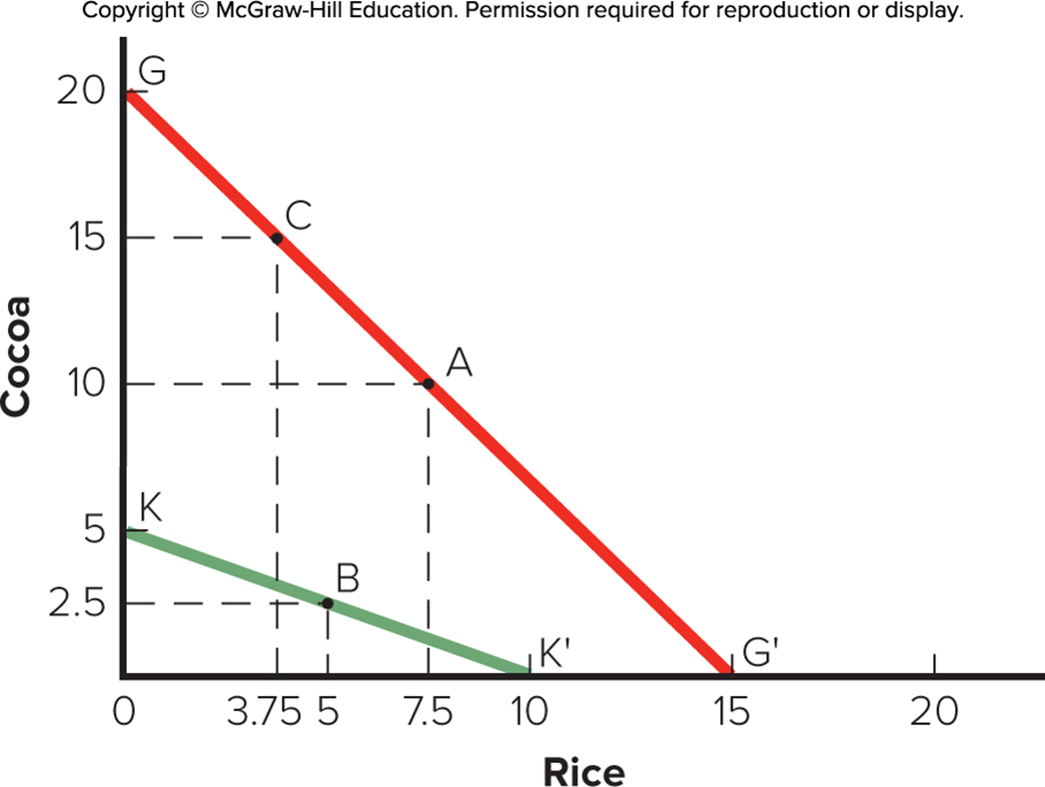
The Theory of Comparative Advantage
Notes:
Assume that Ghana is more efficient in the production of both cocoa and rice. In Ghana, it takes 10 resources to produce one tone of cocoa, and 13 1/3 resources to produce one ton of rice. So, Ghana could produce 20 tons of cocoa and no rice, 15 tons of rice and no cocoa, or some combination of the two. In South Korea, it takes 40 resources to produce one ton of cocoa and 20 resources to produce one ton of rice. So, South Korea could produce 5 tons of cocoa and no rice, 10 tons of rice and no cocoa, or some combination of the two.
A= is the best they can do if they need to produce both

Slide 15
Comparative Advantage and the Gains from Trade
Consumption after Ghana Trades 4 Tons of Cocoa for 4 Tons of South Korean Rice
 | Cocoa | Rice
Ghana | 11.0 | 7.75
South Korea | 4.0 | 6.0
Increase in Consumption as a Result of Specialization and Trade
 | Cocoa | Rice
Ghana | 1.0 | 0.25
South Korea | 1.5 | 1.0
Notes:
The theory of comparative advantage suggests that trade is a positive-sum game in which all countries that participate realize economic gains.
Boths increase in consumption a little → all a little bit better off than they were before

Slide 16
Comparative Advantage
The Gains from Trade
  Trade is a positive-sum game in which all gain.
    Potential world production is greater with unrestricted free trade than with restricted trade.
    Provides a strong rationale for encouraging free trade.
Notes:
The basic message of the theory of comparative advantage is that potential world production is greater with unrestricted free trade than it is with restricted trade. Ricardo’s theory suggests that consumers in all nations can consume more if there are no restrictions on trade.

Slide 17

Classic Theory Conclusion
Free Trade expands the world “pie” for goods/services.
Both sides benefit from free trade.
Free trade makes workers more productive.
  They produce what they produce best.
  Increases total output.
Notes:
Real world: many countries and many goods
Transportation costs may decline with specialization
Prices in different countries can be (are) effected by exchange rates. Wheat and Tea are not necessarily a one-to-one swap
resources can move from country to country: labor (Mexico to US), capital
(constant returns to scale: specialization does not effect the amount of resources required to produce one ton of wheat or tea) both diminishing and increasing returns to specialization exist
assumed fixed stock of resources in each country. Trade can change the efficiency with which the resources are used and the stock of resources may change too (more people, more natural resources, more efficient use due to technology)
Full employment implies use of resources at full efficiency...

Slide 18
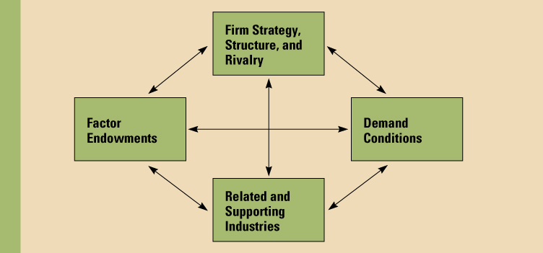
Determinants of Competitive Advantage
Notes:
Porter (1990) tried to explain why a nation achieves international success in a particular industry.
Porter identified four attributes he calls the diamond that promote or impede the creation of competitive advantage:
Factor endowments →
Demand conditions
Related and supporting industries
Firm strategy, structure, and rivalry
In addition, Porter identified two additional variables (chance and government) that can influence the diamond in important ways.

Slide 19
National Competitive Advantage: Porter’s Diamond
Factor Endowments
  Hierarchies among factors:
    Basic: natural resources, climate, location, demographics. (country has; nothing has to do for it)
    Advanced: communication infrastructure, skilled labor, research facilities, technological know-how. (county has to work for it; needed to be established)
  Basic factors can provide initial advantage that is extended by investment in advanced factors.
  Advanced factors are most significant for competitive advantage.
    Example: Japan’s large pool of engineers.
Notes:
Factor endowments lie at the center of the Heckscher–Ohlin theory. While Porter does not propose anything radically new, he does analyze the characteristics of factors of production. He recognizes hierarchies among factors, distinguishing between basic factors (for example, natural resources, climate, location, and demographics) and advanced factors (for example, communication infrastructure, sophisticated and skilled labor, research facilities, and technological know-how).

Slide 20
National Competitive Advantage: Porter’s Diamond
Demand Conditions
  Nature of home demand for an industry’s product or service.
  Influence the development of capabilities.
  Sophisticated and demanding customers pressure firms to be more competitive and produce high-quality, innovative products.
Notes:
Porter emphasizes the role home demand plays in upgrading competitive advantage. Firms are typically most sensitive to the needs of their closest customers. Thus, the characteristics of home demand are particularly important in shaping the attributes of domestically made products and in creating pressures for innovation and quality.
Local demand conditions : demand for better products require company and then enable them to ship it internationally

Slide 21
National Competitive Advantage: Porter’s Diamond
Related and Supporting Industries
  Presence of supplier industries and related industries that are internationally competitive.
  Investing in these industries can spill over and contribute to success in other industries.
  Successful industries are grouped in clusters within countries, prompting knowledge flows between firms.
    Example: Germany’s textile and apparel sector.
    Things which are related will be located next to related things (e.g sheeps next to needle company)
    Sweden was lifted up by the steel/related manufacturing areas
Notes:
The benefits of investments in advanced factors of production by related and supporting industries can spill over into an industry, thereby helping it achieve a strong competitive position internationally. Swedish strength in fabricated steel products (for example, ball bearings and cutting tools) has drawn on strengths in Sweden’s specialty steel industry.

Slide 22
National Competitive Advantage: Porter’s Diamond
Firm Strategy, Structure, and Rivalry
  Different nations are characterized by different management ideologies.
    Either help or do not help them build national competitive advantage.
Notes:
Nations are characterized by different management ideologies which influence the ability of firms to build national competitive advantage. According to Porter, one consequence of these different management ideologies was a relative loss of U.S. competitiveness in those engineering-based industries where manufacturing processes and product design issues are all-important (for example, the automobile industry).
Different management ideologies:
India : hierarchical; authoritarian
Germany: rather democratic

Slide 23
Implications for Business
Location implications:
  Disperse production activities to countries where they can be performed most efficiently
Policy implications:
  Promoting free trade is in the best interests of the home country, not always in the best interests of the firm, even though many firms promote open markets

Slide 24
End of Trade Theory Lecture

